Slide 1
CORTXv2 Cluster with Storage Set
Storage Set 1
Storage Set 2
Network
Network
Node 1
Node 2
Node N1
Node 1
Node 2
Node N2
Server 1
Server 2
Server 2
Server 1
Server 2
Server 2
Enc
1
Enc
3
Enc
3
Enc
1
Enc
3
Enc
3

Slide 2
Server Metadata Layout
Storage Set 1
Storage Set 2
Network
Network
Node 1
Node 2
Node N1
Node 1
Node 2
Node N2
Server 1
Server 2
Server 2
Server 1
Server 2
Server 2
Global Bucket Index
Key: Bucket Value: Account ID
Bucket List Index
Key: AcctID/Bucket​ Value: ​Obj List Indx,​ Multipart obj indx​, Version list indx, Pool Version for SS
New Field to find storage set of
‘Object List Index’
Object List Index
Key: ObjectName​ Value: m_oid, Pool Version, Layout ID
Object

Slide 3
Motr-Hare HA Interface & Interaction
Hare
Notify Node
Status
Notify DG Status
Stob IO
Failure
Motr
SS2 : Node 3 : DG1
Pool A (Storage Set 1)
Volume Nd1 : DG1
Volume Nd1 : DG2
Volume Nd2 : DG1
Volume Nd2 : DG2
Volume Nd3: DG1
Volume Nd3: DG2
Note: Once a DG is marked as failed, a new Pool version will get created and associated with Poon B
Pool B (Storage Set 2)
Volume Nd1 : DG1
Volume Nd1 : DG2
Volume Nd2 : DG1
Volume Nd2 : DG2
Volume Nd3: DG1
Volume Nd3: DG2
- Object write will skip volume - Object read will do degraded read
Pool X (Storage Set N)
Volume Nd1 : DG1
Volume Nd1 : DG2
Volume Nd2 : DG1
Volume Nd2 : DG2
Volume Nd3: DG1
Volume Nd3: DG2

Slide 4
Storage Set Details
Network
Server : 1
Server : N
Motr-1
Motr-2
Motr-1
Motr-2
IOS-1
CAS-1
IOS-2
CAS-2
IOS-1
CAS-1
IOS-2
CAS-2
CAS-2
Access Layer
Access Layer
Volume – DG1
Volume – DG2
Volume – DG1
Volume – DG2
Enclosure 1
Enclosure 1
Firmware (ADAPT)
Firmware (ADAPT)
Controller 1
Controller 2
Controller 1
Controller 2
SAS Expanders
SAS Expanders
Disk Group 1 (DG1)
Disk Group 2 (DG2)
Disk Group 1 (DG1)
Disk Group 2 (DG2)

Slide 5
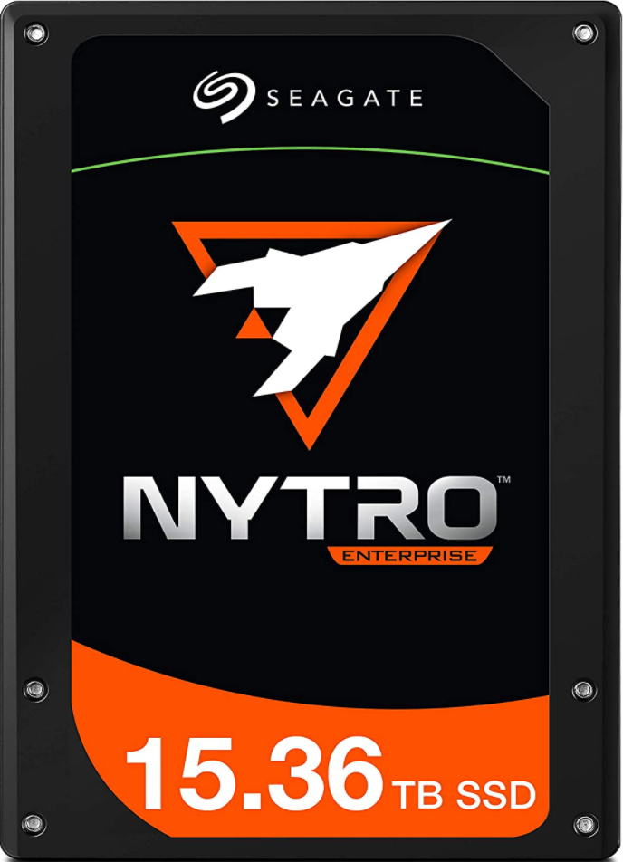
Enclosure SSD Configuration For Metadata
Access Layer
Volume – DG1
Volume – DG2
MD
Performance Affinity
Affinity
Enclosure
Disk Group 1 (DG1) : Performance
Disk Group 1 (DG1) : Standard
Disk Group 1 (DG1) : Performance
Disk Group 1 (DG1) : Standard
Ideally SSD Capacity >= Metadata Volume Size / 2

